Slide 1

Data Structures Lecture: Sorting Techniques
By
Nitish Kumar
Asst. Professor
Lovely Professional University, Punjab

Slide 2
Outlines
Introduction
Insertion Sort
Bubble Sort
Selection Sort

Slide 3
Sorting (Bubble Sort)
What does bubble sort mean?
The name bubble sort comes from the fact that smaller or larger elements "bubble" to the top of a dataset. In the previous example of [3, 1, 4, 2], the 3 and 4 are bubbling up the dataset to find their proper positions.
This algorithm is alternatively called the sinking sort for the opposite reason; some of the elements are sinking to the bottom of the dataset. In our example, the 1 and the 2 are sinking elements

Slide 4
Sorting
Sorting is the process of arranging the elements of an array so that they can be placed either in ascending or descending order.
For example, consider an array A = {A1, A2, A3, A4, ?? An }
Why Sorting Algorithms are Important
Since they can often reduce the complexity of a problem, sorting algorithms are very important in computer science. These algorithms have direct applications in searching algorithms, database algorithms, divide and conquer methods, data structure algorithms, and many more.
Notes:
목차
자바의 생성배경
자바를 사용하는 이유
과거, 현재, 미래의 자바
자바의 발전과정
버전별 JDK에 대한 설명
자바와 C++의 차이점
자바의 성능
자바 관련 산업(?)의 경향

Slide 5
Bubble sort
Bubble Sort is the simplest sorting algorithm that works by repeatedly swapping the adjacent elements if they are in the wrong order. This algorithm is not suitable for large data sets as its average and worst-case time complexity is quite high.

Slide 6
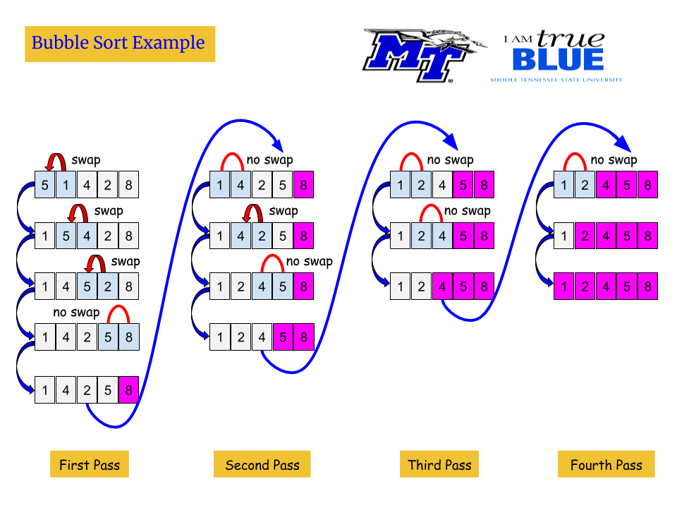

Slide 7
Time Complexity Analysis of Bubble Sort:
Best Case: The best case occurs when the array is already sorted. So the number of comparisons required is N-1 and the number of swaps required = 0. Hence the best-case complexity is O(N).
Worst Case: The worst-case condition for bubble sort occurs when elements of the array are arranged in decreasing order. In the worst case, the total number of iterations or passes required to sort a given array is (N-1). where ‘N’ is the number of elements present in the array.
At pass 1: Number of comparisons = (N-1) Number of swaps = (N-1)
At pass 2: Number of comparisons = (N-2) Number of swaps = (N-2)
At pass 3: Number of comparisons = (N-3) Number of swaps = (N-3) .

Slide 8
At pass N-1: Number of comparisons = 1 Number of swaps = 1
Now, calculate total number of comparison required to sort the array = (N-1) + (N-2) + (N-3) + . . . 2 + 1 = (N-1)*(N-1+1)/2 { by using sum of N natural Number formula } = (N * (N-1)) / 2
In worst case, Total number of swaps = Total number of comparison Total number of comparison (Worst case) = N(N-1)/2 Total number of swaps (Worst case) = N(N-1)/2
So worst case time complexity is O(N²) as N² is the highest order term.
Average Case Time Complexity: The number of comparisons is constant in Bubble Sort. So in average case, there are O(N2) comparisons. This is because irrespective of the arrangement of elements, the number of comparisons C(N) is same.

Slide 9
Bubble Sort Algorithm
BUBBLE_SORT(A, N)
Step 1: Repeat Step 2 For I= 0 to N-1
Step 2: Repeat step 3 For J =0 to N - I
Step 3: IF A[J] > A[J + 1]
SWAP A[J] and A[J+1]
[END OF INNER LOOP]
[END OF OUTER LOOP]
Step 4: EXIT
Notes:
목차
자바의 생성배경
자바를 사용하는 이유
과거, 현재, 미래의 자바
자바의 발전과정
버전별 JDK에 대한 설명
자바와 C++의 차이점
자바의 성능
자바 관련 산업(?)의 경향

Slide 10
Insertion Sort

Slide 11
Insertion Sort
Insertion sort works similar to the sorting of playing cards in hands. It is assumed that the first card is already sorted in the card game, and then we select an unsorted card. If the selected unsorted card is greater than the first card, it will be placed at the right side; otherwise, it will be placed at the left side. Similarly, all unsorted cards are taken and put in their exact place.
The same approach is applied in insertion sort. The idea behind the insertion sort is that first take one element, iterate it through the sorted array.

Slide 12
Technique
Insertion sort works as follows:
The array of values to be sorted is divided into two sets. One that stores sorted values and another that contains unsorted values.
The sorting algorithm will proceed until there are elements in the unsorted set.
Suppose there are n elements in the array. Initially, the element with index 0 (assuming LB = 0) is in the sorted set. Rest of the elements are in the unsorted set.
The first element of the unsorted partition has array index 1 (if LB = 0).
During each iteration of the algorithm, the first element in the unsorted set is picked up and inserted into the correct position in the sorted set.

Slide 13
Example of insertion sort
8
2
4
9
3
6

Slide 14
Example of insertion sort
8
2
4
9
3
6

Slide 15
Example of insertion sort
8
2
4
9
3
6
2
8
4
9
3
6

Slide 16
Example of insertion sort
8
2
4
9
3
6
2
8
4
9
3
6

Slide 17
Example of insertion sort
8
2
4
9
3
6
2
8
4
9
3
6
2
4
8
9
3
6

Slide 18
Example of insertion sort
8
2
4
9
3
6
2
8
4
9
3
6
2
4
8
9
3
6

Slide 19
Example of insertion sort
8
2
4
9
3
6
2
8
4
9
3
6
2
4
8
9
3
6
2
4
8
9
3
6

Slide 20
Example of insertion sort
8
2
4
9
3
6
2
8
4
9
3
6
2
4
8
9
3
6
2
4
8
9
3
6

Slide 21
Example of insertion sort
8
2
4
9
3
6
2
8
4
9
3
6
2
4
8
9
3
6
2
4
8
9
3
6
2
3
4
8
9
6

Slide 22
Example of insertion sort
8
2
4
9
3
6
2
8
4
9
3
6
2
4
8
9
3
6
2
4
8
9
3
6
2
3
4
8
9
6

Slide 23
Example of insertion sort
8
2
4
9
3
6
2
8
4
9
3
6
2
4
8
9
3
6
2
4
8
9
3
6
2
3
4
8
9
6
2
3
4
6
8
9
done

Slide 24
Insertion Sort
INSERTION_SORT (A, N)
INSERTION-SORT (ARR, N)
Step 1: Repeat Steps 2 to 5 for i = 1 to N – 1
Step 2: SET TEMP = ARR[i]
Step 3: SET J = i – 1 //comparison
Step 4: Repeat while (j>=0 && a[j] > temp)
SET ARR[J + 1] = ARR[J]
SET J = J - 1
[END OF INNER LOOP]
Step 5: SET ARR[J + 1] = TEMP
[END OF LOOP]
Step 6: EXIT

Slide 25
Advantages of Insertion Sort
The advantages of this sorting algorithm are as follows:
It is easy to implement and efficient to use on small sets of data.
It can be efficiently implemented on data sets that are already substantially sorted.
It performs better than algorithms like selection sort and bubble sort. Insertion sort algorithm is simpler than shell sort, with only a small trade-off in efficiency. It is over twice as fast as the bubble sort and almost 40 per cent faster than the selection sort.
It requires less memory space (only O(1) of additional memory space).
It is said to be online, as it can sort a list as and when it receives new elements

Slide 26
Insertion Sort Complexity
This Sorting algorithm is frequently used when n is very small.
Worst case occurs when array is in reverse order. The inner loop must use K – 1 comparisons.
f(n) = 1 + 2 + 3 + ….+ (n – 1) = n(n – 1)/2 = O(n²)
In average case, there will be approximately (K – 1)/2 comparisons in the inner loop.
f(n) = 1 + 2 + 3 + ….+ (n – 1)/2 = n(n – 1)/4 = O(n²)

Slide 27


